Slide 1
LAC ATIP: There’s A Revolution Underway
Panel 3: Making the ATI Process Work
Accessing Historic Records on Intelligence and
International Affairs (organized by CFHIP)
October 20, 2023
Kristina Lillico
Director General, ATIP Branch
& ATIP Coordinator

Slide 2
Context: Information Commissioner Reports
The Information Commissioner of Canada (OIC) conducted a systemic investigation into LAC’s difficulties in meeting the deadlines set out in the Access to Information Act and produced two reports on April 26, 2022:
  Library and Archives Canada - Systemic Investigation Report
  Access at issue: The challenge of accessing our collective memory
Starting in April 2022, LAC received $100.6 million of funding over 6 years to address its Access to Information and Privacy (ATIP) backlog and have funding to respond to class action litigations.
LAC published an Action Plan in response to the OIC reports and to set the direction for its focussed improvements.
Notes:
10 Recommendations:
Direct LAC ATIP officials to use their delegated authority to respond to all access requests with outstanding consultations forthwith.
Direct LAC ATIP officials, for new access requests requiring consultations, to establish a rigorous process to determine the length of time the consultations should take and to respond to those requests before the expiry of the extension sought, with or without the institutions’ input.
Process all pending access requests for records classified as Top Secret forthwith, even as implementation and certification of new infrastructure continues.
Respond to the backlog of access requests that resulted from LAC suspending ATIP operations during the pandemic.
Implement fully functional infrastructure to allow ATIP officials to process Secret and Top Secret records efficiently.
Ensure ATIP officials have access to the LAC network and record-processing software at all times, so LAC is always in a position to respond to access requests.
Require institutions to review and, whenever possible, declassify or downgrade the classification of records prior to transferring them to LAC.
Negotiate adequate funding for LAC’s ATIP office to support new programs introduced by other institutions.
Review and adjust the permanent funding for the various units with the ATIP office to reflect their workload.
Publish on the LAC website by the end of 2022 the concrete results achieved to implement these recommendations and provide quarterly updates.
How did we get here?
1) Growth:
LAC ATIP Requests Received (including formal and informal):
2017-18 = 14,331
2018-19 = 15,619
2019-20 = 17,190
2020-21 = 12,801
2021-22 = 12,414
2022-23 = 11,215
Number of requests carried forward (including backlog):
2017-18 = 6,310
2018-19 = 8,409
2019-20 = 12,218
2020-21 = 16,922
2021-22 = 18,212
2022-23 = 18,130
2) Changes in Bill C-58, removal of fees beyond 5$, pressures across the ATI system
3) Increase in volume and complexity (content of requests to be analyzed)

Slide 3

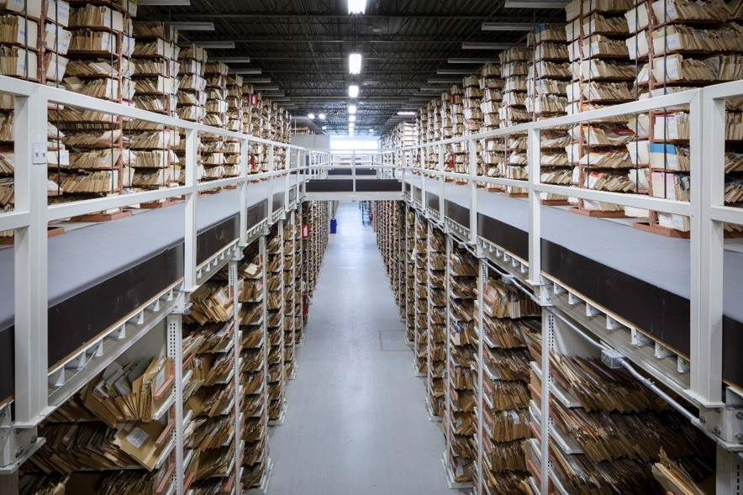
LAC’s Challenge:
How can we do ATIP differently?
How can we open more records proactively?
How will we make ATIP the last resort to access historical records?

Slide 4
LAC ATIP Action Plan
1. Getting back on track
- Decrease backlog
- Reduce OIC complaints queue
2. Internal review and improvements
- Renew policies and processes
- Invest in IT
- Ensure business stability and continuity
3. Engage on broader ATIP issues
- Engage with GC partners
- Engage with international organizations
- Engage with clients and public*
Notes:
Link

Slide 5
Accomplishments so far! (and we’re still going)
ATIP Action Plan - Expected results for 2023-24 | Accomplished
Reduce the ATIP backlog by 40% | ✓
Respect statutory time limits on 30% of new ATIP requests | ✓
Reduce the backlogged complaints from OIC by 32% | ✓
Reduce number of pages sent out for consultation on new requests (approximately 92%) | ✓
Increase the number of completed responses to ATIP requests by 25% | ✓
Onboarding to ATIP Online Request – AIPRP en ligne | ✓
Increase number of workstations for classified secret and classified Top Secret material | ✓
ONGOING & NEXT STEPS:
OIC Orders and Federal Court proceedings
New policies and procedures
  Delegation Instrument
  Archival Research
  Consultations
  Sunset Clauses
  Business stability and continuity
Implement revised Proactive Access processes (such as Block Review)

Slide 6
Oh How We Have Grown!
ATIP has now officially become a Branch
Since spring 2022, LAC ATIP has grown to a team of more than 150 employees
Access to Information and Privacy Branch
Kristina Lillico,
Director General
Privacy, Personnel Records and Indigenous Requests Division
Boris Stipernitz, Director
Access to Information Division
Véronique Gendron, Director
ATIP Operations Support Division
Amy Tector, A/Director
Notes:
Accelerated growth comes with growing pains, onboarding, training, adjusting to new procedures
Competing with ATI across the GC for qualified ATIP personnel
FY 2023-24 settling into new routines and seeing substantial progress against backlog and in new ways of doing

Slide 7
How We Are Already Doing it Differently
Archival Research
  Better informed analysis
  Consultation process
Proactive Access approaches
  Block Review
Declassification projects (more coming on this in panel 4)

Slide 8
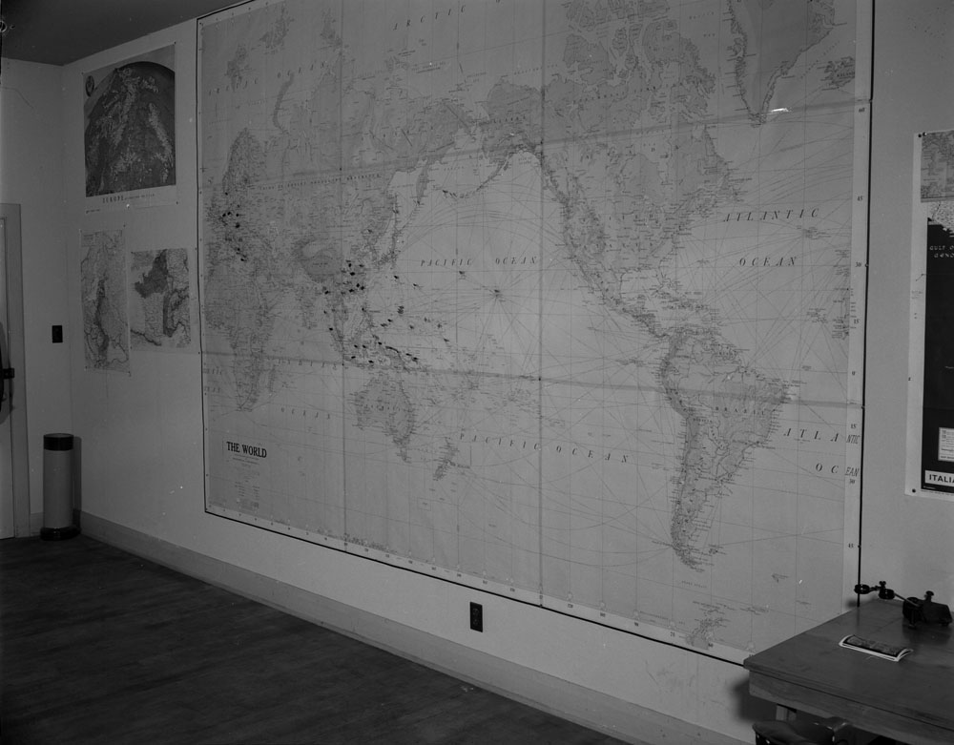
Archival Research
The ATIP Archival Research Team conducts research to discover what information is already disclosed or publicly available to inform LAC’s analysis in how we exercise discretion and to reduce the need for consultations.
LAC consults creating departments or other departments implicated in the records when we identify exemptions that could still apply (not an exhaustive list):
  International Affairs and Defence
  Law Enforcement and Security
  Economic interests
  Or, when seeking advice on releasing other potentially sensitive information
Notes:
Reduces the length of extensions
Beginning to apply new processes to backlog requests –
Tips for submitting requests:
Please do not re-submit requests
As much as possible, provide archival references
2 out of 82 research requestst related to Military and Intelligence records sent to the Archival Research team required an external consultation.

Slide 9
Proactive Access
Block Review (BR)
Proactive Review (ProR)
Risk-based approach, but risk is mitigated
Ideal for series of records (blocks)
There are exemptions
High reward- Preferred approach whenever possible
No in-file redaction; either it’s open or it’s not
Page by page, full reviews
Public/research interest is central
Lower risk, possibility to review records of higher sensitivity (and in general, higher public interest)
Time-consuming processes that can be very lengthy, with material redaction
Rejected candidates
Level of risk
Time Spent

Slide 10
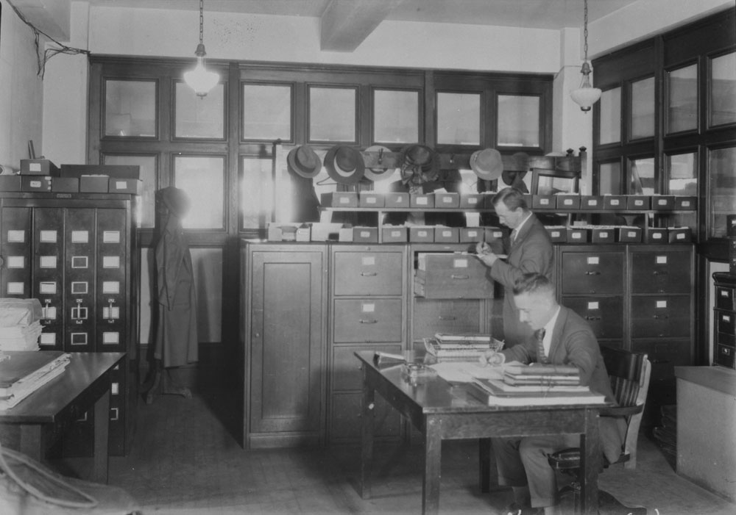
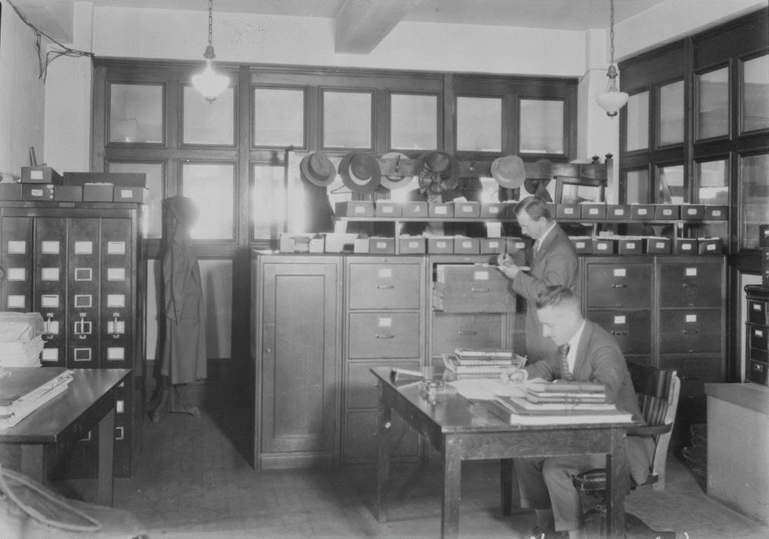
Plans for Block Review
Short-term to mid-term
Make team operational/functional again (staffing)
Lay of the land, close the review files underway that need to be closed and open the records
New projects: there is a waiting list!
Establish a 3-5 year plan
Mid-term to long-term
Make Block Review a systematic, regular review program, integrated into the ATIP triage process
Review the procedures, make it more efficient and
Make it known!
Notes:
We are investigating sunset clauses, or time-limited exemptions/passage of time principle.

Slide 11
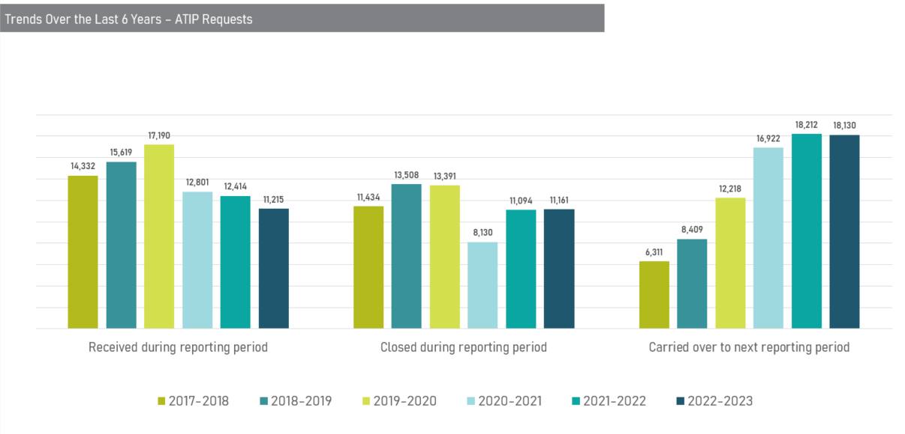
2022-2023 ATIP Statistics
11,215
Requests received
11,161
Requests
closed
18,130
Requests carried forward

Slide 12
ATI Requests - Military and Intelligence Records
Formal requests processed under the Access to Information Act in 2022-2023 related to Military and Intelligence Records
Requests completed | 255
Within legislated time frames | 126
Past legislated time frames | 129
# of pages reviewed | 89,268
# of pages released | 83,757
Formal requests to be processed under the Access to Information Act related to Military and Intelligence Records
Total Outstanding Requests | 1,652
Within legislated time frames | 238
Past legislated time frames | 1,414
Outstanding requests with pages reviewed | 1,239
Total pages reviewed | 487,425
Requests awaiting consultation response | 492
Total pages out on consultation | 253,851
Notes:
Formal requests processed under the Access to Information Act 2022-2023
Files of former Canadian Armed Forces members and former federal public servants : 1,350
GC archival records: 523
LAC operational records: 13
Total: 1,886

Slide 13
ATIP Backlogged Requests
Types of records | Backlogged as of September 30, 2021 | Completed | Remaining as of October 13, 2023
Files of former Canadian Armed Forces members and former federal public servants | 13,290 | 6,708 | 6,582
GC archival records | 3,422 | 1,673 | 1,749
LAC operational records | 35 | 35 | 0
Total | 16,747 | 8,416 | 8,331

Slide 14
Next Steps in the LAC ATIP Revolution
Continuing to reduce backlog while also improving responses to new incoming requests
  Reduce the potential for future complaints
Refining consultation procedures, informed by the Archival Research team processes
Embedding proactive approaches up front in the ATIP request process
Continuing to introduce new procedures such as sunset clauses to align with international counterparts
Contributing to GC wide efforts around declassification and advancing declassification projects at LAC

Slide 15
Questions:
Kristina Lillico
Director General, ATIP Branch & ATIP Coordinator
kristina.lillico@bac-lac.gc.ca
For questions on specific ATIP requests being processed:
daiprp-atipd@bac-lac.gc.ca

