Slide 1
Treating Historical Access to Information and Privacy (ATIP) Requests at Global Affairs Canada Canadian Foreign Intelligence History Project Symposium Presentation October 20, 2023
Sébastien Chiasson
Access to Information and Privacy Protection Division
Global Affairs Canada

Slide 2
Presentation Outline
Building Team Historical.
Modifying the ATIP Process.
Tools and Resources.
Collaboration with Partners and Stakeholders
Ongoing Challenges
Future Initiatives
Suggestions to Researchers

Slide 3
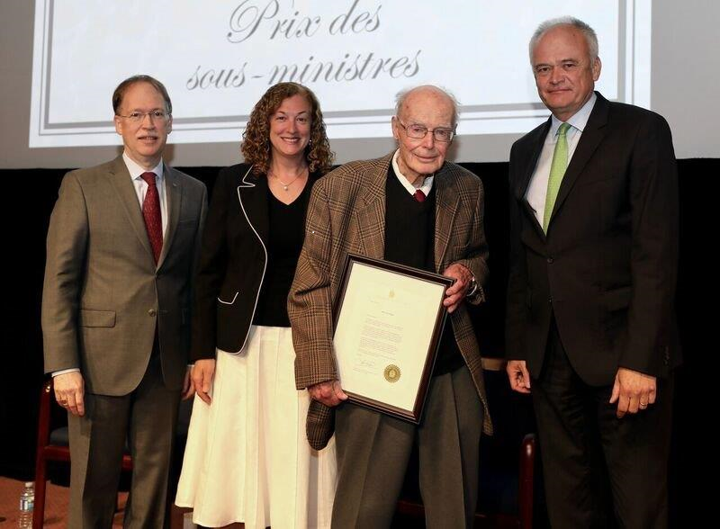
Reason for Building a Standalone Team
Surge of ATIP requests for historical material since 2017 – mainly intelligence.
Death of Lawrence Smith in May 2019.
Growing large backlog of consultation requests with 50% containing top secret material.
Lack of tools and staff to process top secret.
Complexity of treating historical material.
Consistency issues.
Lawrence Smith receiving special certificate in 2017 signed by Prime Minister Trudeau, recognizing his long service of over 60 years at GAC’s Deputy Ministers’ Award Ceremony.

Slide 4
Modifying the ATIP Process
Establishing a consistent approach when treating historical material. A few examples include:
Cross referencing - online and through repositories.
Consultant review - reduce internal consultations.
Collaborative workflow – from consultant to analyst.
Consultation process – minimize volume and proposed release packages.
Establishing a set of pertinent question to challenge on severances.

Slide 5
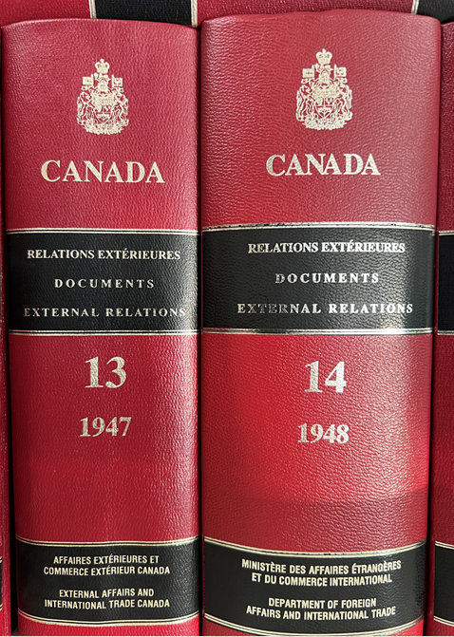
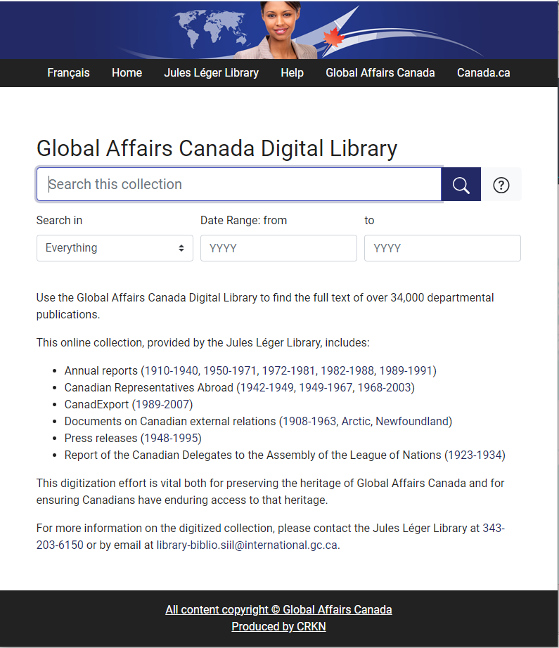
Building Tools and Resources
Canadian Foreign Intelligence History Project Database.
Digital tools and establishing protocols to treat top secret material.
List of online resources for research.
Building a Library
Creating guidelines and educating the department.

Slide 6
Collaboration with Partners and Stakeholders
Within Global Affairs Canada
External Review and Transparency Unit
Information Management Support and Services
Historical Section
Other Government Departments
Processing ATIP consultation requests.
Sharing and comparing policies and tools.
Requesters
Tools and resources
Context and background
Re-scoping the request text

Slide 7
Some Ongoing Challenges
Lack of a Canada-wide declassification structure with more reliance on the Access to Information Act to treat historical records.
No clear step-by-step procedures on downgrading material.
There is insufficient historical subject matter expertise during consultations, causing subject matter experts on contemporary matters to treat historical record in the same fashion as modern ones.
Limited numbers of staff with proper clearance to process and review.
Additional time required to cross-reference with publicly released material.

Slide 8
Future Initiatives
Establishment of a GAC-wide policy on the treatment of historical material.
Possible collaborative approaches with other countries.
Foreign consultation
Comparing approaches
Streamlining the process across departments.
Testing different ways to reduce duplication of efforts.

Slide 9
Suggestions to Researchers – Making ATIP Requests
Crafting your request text
Timeframe
Exclusions
Specific as possible.
Targeted step-by-step approach
Additional context
Share background information and primary sources found in the public domain.

Slide 10
Questions and Helpful Links
General media inquiries can be submitted to media@international.gc.ca.
You can make your requests at https://atip-aiprp.tbs-sct.gc.ca/
Questions? Feel free to contact me at sebastien.chiasson@international.gc.ca
Thank you!

